Slide 2
Voice Commands
via Siri
iCloud
iPhone 6+
Apple TV
HomeKit
HomeKit
<<BLE>>
Device Specific Apps
<<BLE>>
<<BLE>>
<<WiFi>>
<<WiFi>>
BLE Devices
(b₁ - b₆)
Raspberry Pi
Homebridge
-WeMo Plugin
BLE Devices
(b₇ - b₁₁)
<<WiFi>>
User in Smart Home
WiFi Devices
(w₂ - w₉)
User away from Smart Home

Slide 3
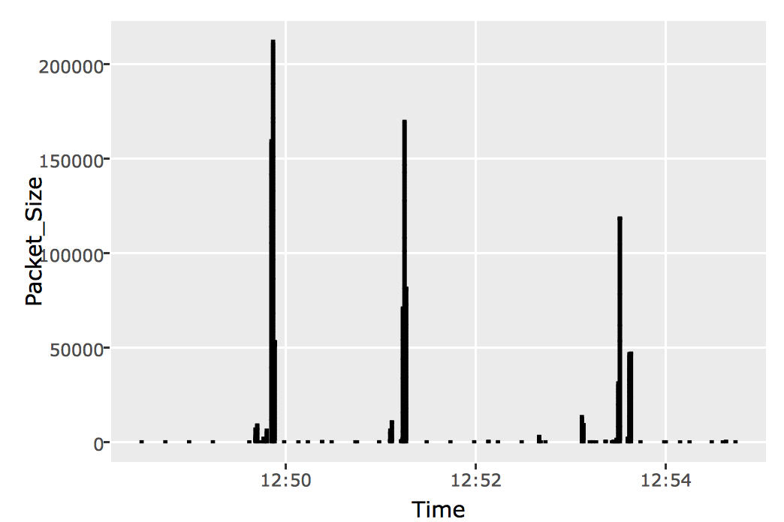
Homebridge
Logs
.csv
IoTCIT
Passive
Sniffing
Device Classification,
Event ID,
User Tracking
Import,
Visualize data
BLE Devices
Plots
.pcap
.csv
WiFi Devices
Test Matrix
Logs
.csv

Slide 4
Smart Home
Host Machine

Slide 5
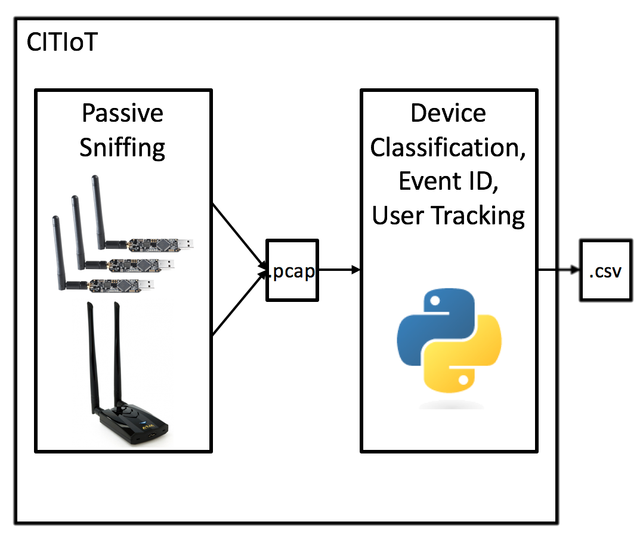
Smart Home
Observer Machine

